Slide 1

CSC 533: Privacy in the Digital Age (Fall 2020) Lecture 9: Stateless Online Tracking
Anupam Das
Sept. 10, 2020

Slide 2
Goals for today
What is stateless tracking?
Different ways to do stateless tracking
Browser and OS level properties
Hardware level properties
Some contents are borrowed from online material provided by Nataliia Bielova

Slide 3
Recap: Cookie based tracking
Type (Name) | Scope | User Visits Directly? | Overview
1st party | Within-Site | Yes | Site does its own on-site analytics.
Analytics | Within-Site | No | Site uses third-party analytics engine (e.g., Google Analytics).
Vanilla | Cross-Site | No | Site embeds third-party tracker that uses third-party storage (e.g., Doubleclick).
Forced | Cross-Site | Yes (forced) | Site embeds third-party tracker that forced the user to visit directly (e.g., via popup).
Referred | Cross-Site | No | Tracker relies on another cross-site tracker to leak unique identifier values.
Personal | Cross-Site | Yes | Site embeds third-party tracker that the user otherwise visits directly (e.g., Facebook).
Evolution: Embedding analytics libraries
Evolution: Third-party cookie blocking
Evolution: Complex ad networks
Evolution: Social networks

Slide 4
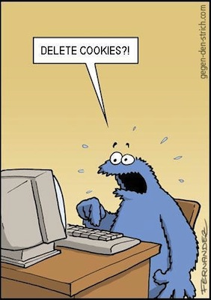
Recap: Cookie respawning
Cookies can respawn even if the user has deleted them
HTML5 localStorage (across sessions only)
Flash LSOs (across sessions and web browsers)
HTTP headers: Etag, LastModified
A. Soltani http://ashkansoltani.org/2011/08/11/respawn-redux-flash-cookies/

Slide 5



Yet digital stalking is possible
What if you could track users without the need of cookies or any other stateful client-side identifier?
Hidden from users
Hard to block/opt-out
Web-based device fingerprinting
Certain attributes of your browser environment can be used to accurately track you
These attributes, when combined, create a quite unique fingerprint of your system

Slide 6
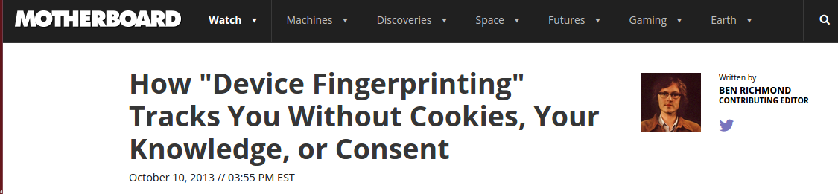

Device Fingerprinting
$$h \left( \right)=$$
Stateless

Slide 7

Device fingerprinting techniques
How are device fingerprints created?
Network
IP address
RTT
Browser
User agent
Extensions
OS
Fonts
TCP/IP response
Hardware
Screen size
Clock
IP: 71.61.178.35
https://panopticlick.eff.org/
https://amiunique.org/
$$h \left( \right)=$$
Notes:
So how do we generate device fingerprints? Device fingerprinting can happen at different layers of the software or hardware stack-
For example,
At the network layer, IP address and RTT (round-trip-time) can be used to profile users’ device
At the application layer, browser can expose user-agent string
At the OS level (fingerprint the underlying OS), the collection of fonts
At the hardware level, screen resolution can be used to identify devices
At a high-level small deviations in the network, software or hardware stack can uniquely help create device fingerprints.
Here are some sites where you check the different ways how device fingerprint can be created.

Slide 8

Browser fingerprint

Slide 9
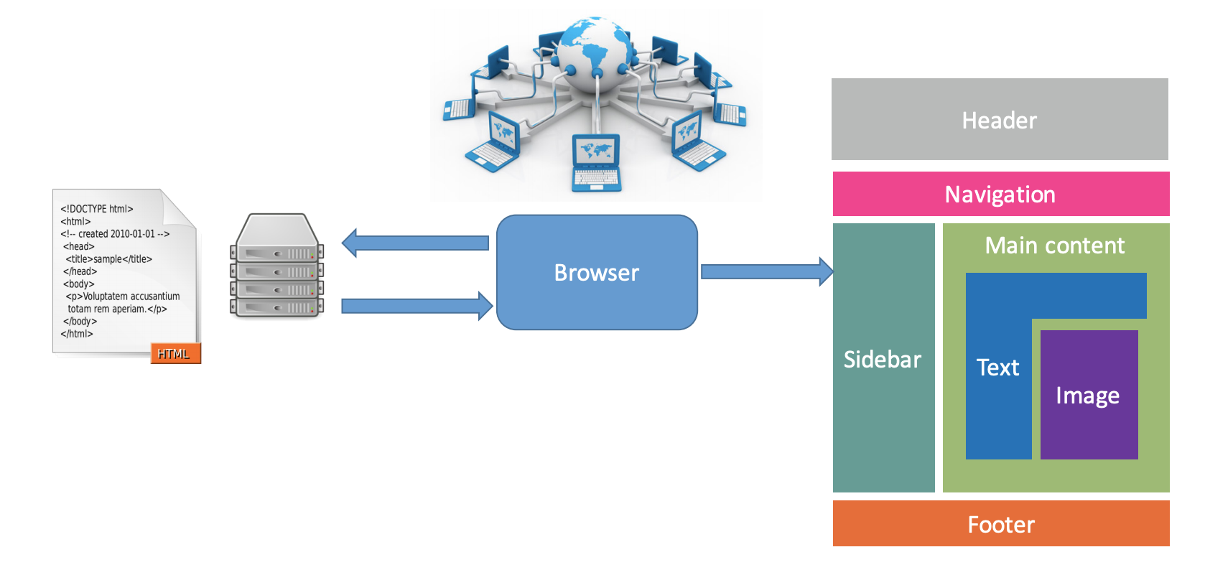
Internet and web browsers
HTTP User agent
I am
I am
Browsers send device-specific information to servers to improve user experience on the web.

Slide 10

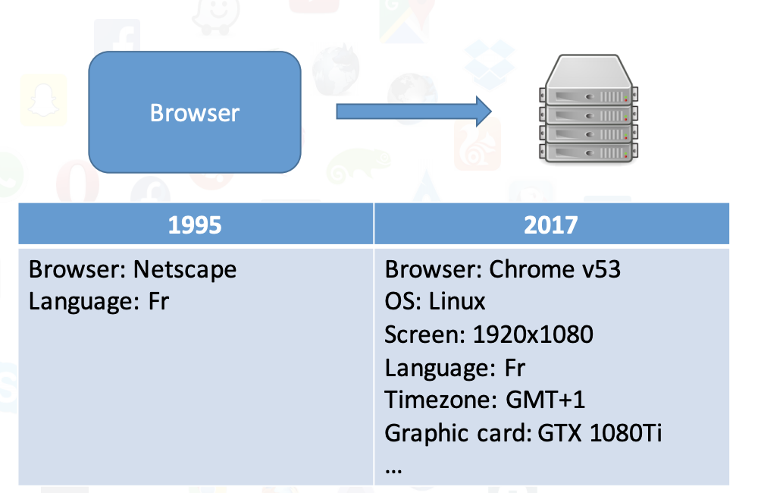
The Web has evolved
A bigger and richer web
Audio
Video
3D rendering Real-time communications
Web payments Virtual reality
What happens when we start collecting all the information available in a web browser?

Slide 11

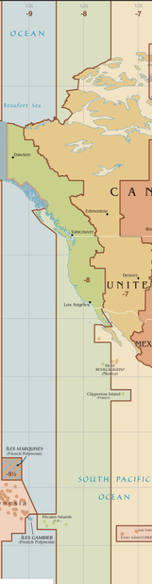






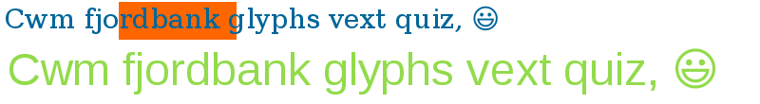

Example of a browser fingerprint
Attribute | Value
User agent | Mozilla/5.0 (X11; Fedora; Linux x86_64; rv:55.0) Gecko/20100101 Firefox/55.0
HTTP headers | text/html, application/xhtml+xml, application/xml;q=0.9,*/*;q=0.8 gzip, deflate, br en-US,en;q=0.5
Plugins | Plugin 0: QuickTime Plug-in 7.6.6; libtotem-narrowspace-plugin.so; Plugin 1: Shockwave Flash; Shockwave Flash 26.0 r0; libflashplayer.so.
Fonts | Century Schoolbook, Source Sans Pro Light, DejaVu Sans Mono, Bitstream Vera Serif, URW Palladio L, Bitstream Vera Sans Mono, Bitstream Vera Sans, ...
Platform | Linux x86_64
Screen resolution | 1920x1080x24
Timezone | -480 (UTC+8)
OS | Linux 3.14.3-200.fc20.x86 32-bit
WebGL vendor | NVIDIA Corporation
WebGL renderer | GeForce GTX 650 Ti/PCIe/SSE2
Canvas
Courtesy of Pierre Laperdrix

Slide 12
Definition of browser fingerprint
A browser fingerprint is a set of information related to a user’s device from the hardware to the operating system to the browser and its configuration.
Browser fingerprinting refers to the process of collecting information through a web browser to build a fingerprint of a device.

Slide 13
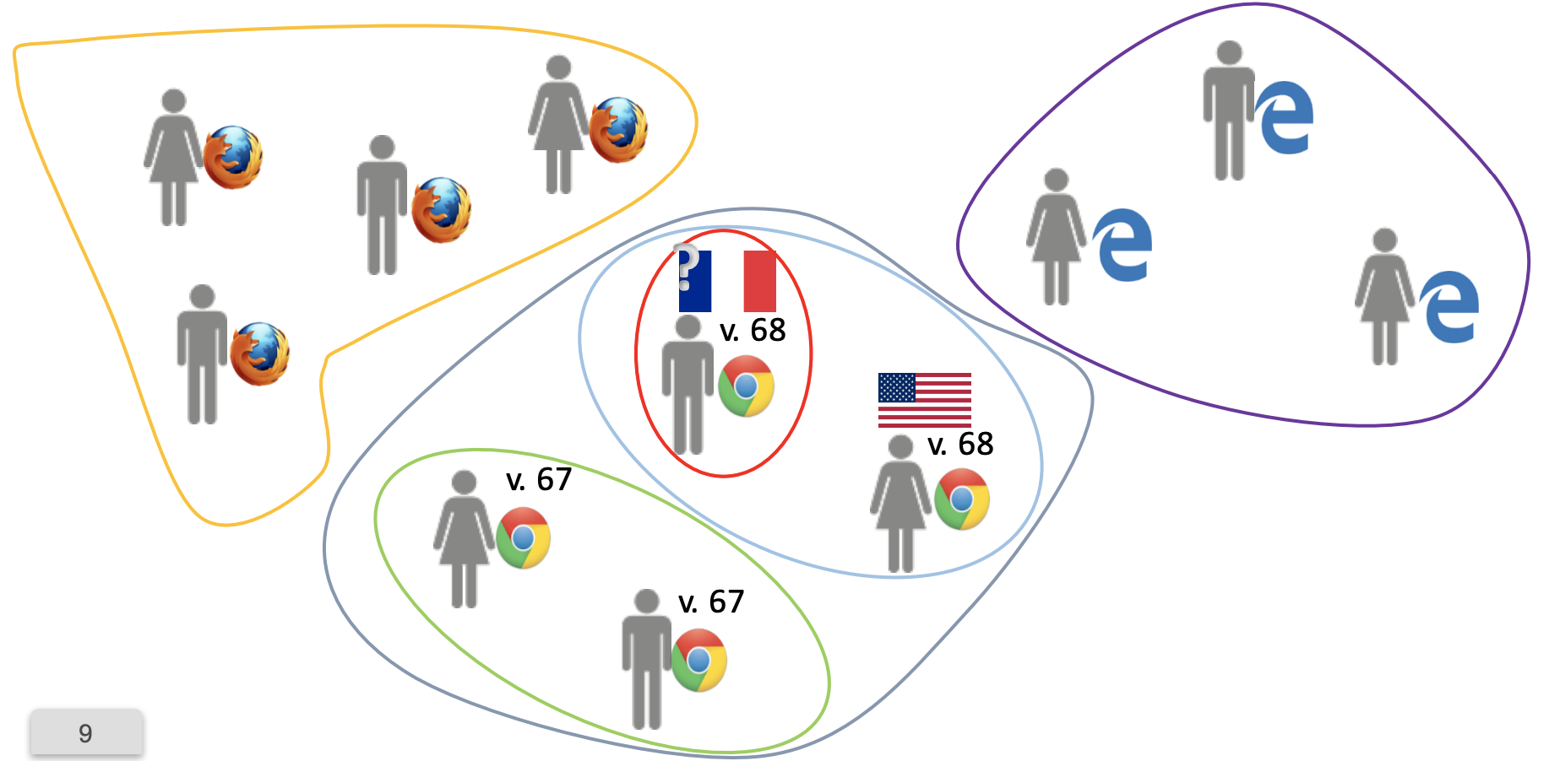
How can browser fingerprint identify us?
Browser type,
Browser version
Language,
Time-zone

Slide 14
Browser fingerprinting used for tracking
Browser and operating system properties are used to track repeated visits to a site.
Tracker.com
http://site1.com
Fingerprint.js
<script src=tracker.com/fingerprint.js>
</script>
processing engine
9:30am: user cx23w4252sdw visited site1.com
Script
tracker.com/track?fng_id=cx23w4252sdw&site=site1.com
logs

Slide 15
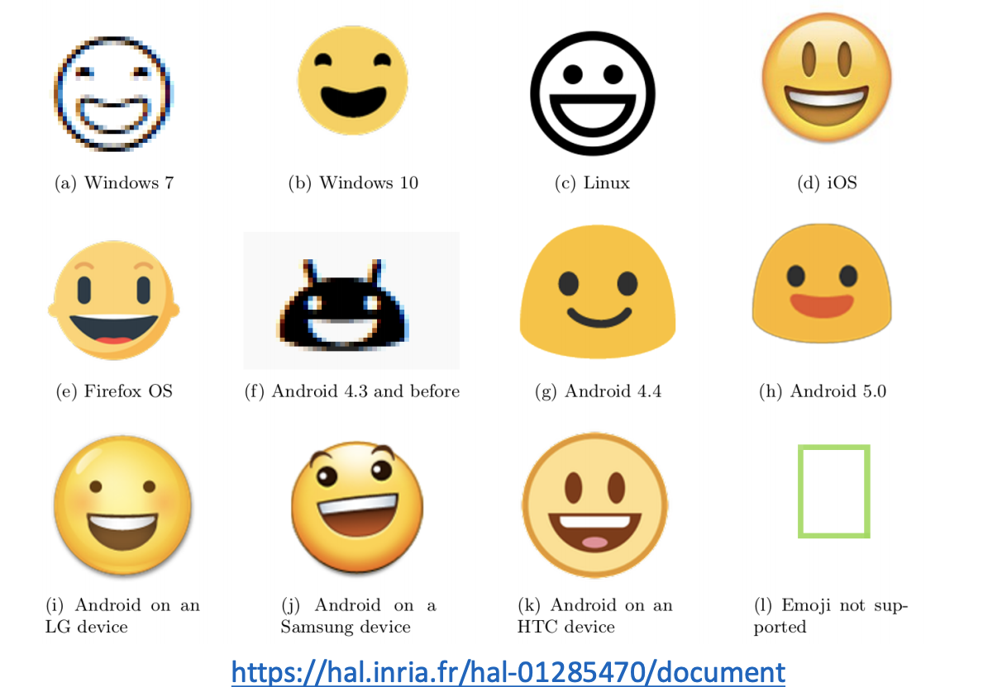
Comparison of the emoji on different devices and OSs

Slide 16
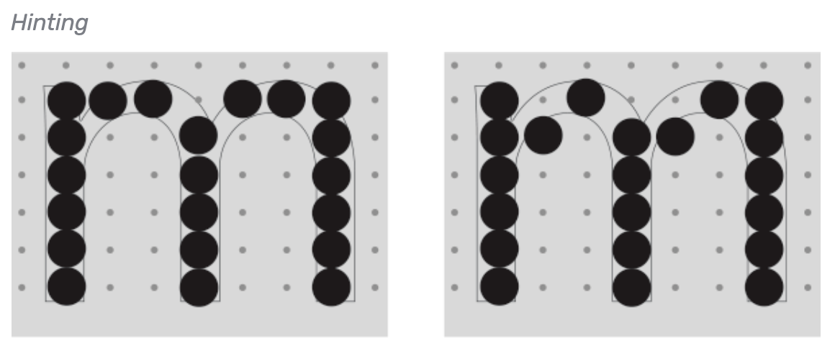
Canvas fingerprint
Canvas fingerprinting [Mowery & Shacham 2012]:
Hash browser-rendered text
var canvas = document.querySelector('canvas’);
var c =canvas.getContext('2d’);
…..
c.drawImage( ….)
….
var v = c. getImageData()
hash(v. data)
Why does it work?
Depends on browser, OS, fonts, GPU
Draw complex objects
Fingerprint
By 2014, 5.5% of Alexa top 100K sites were using canvas fingerprinting [Acar et al. 2014]

Slide 17
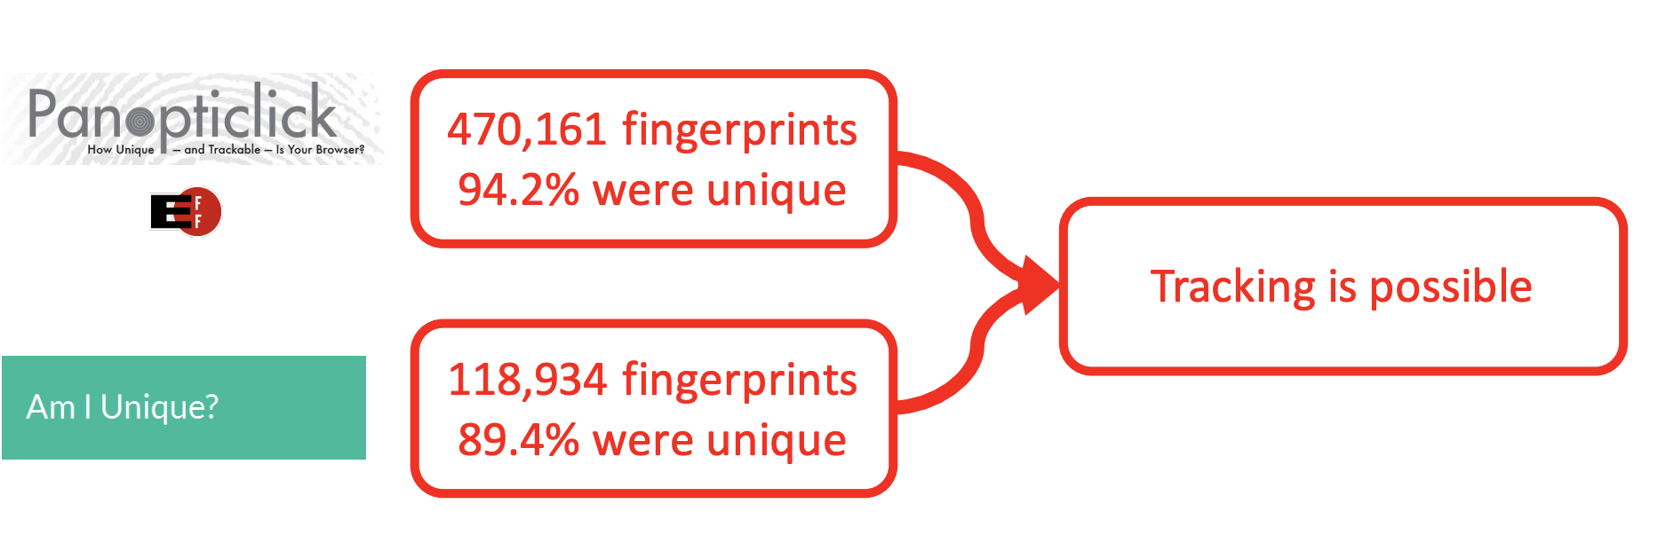
Real-world studies
Two studies have investigated the diversity of browser fingerprints.

Slide 18
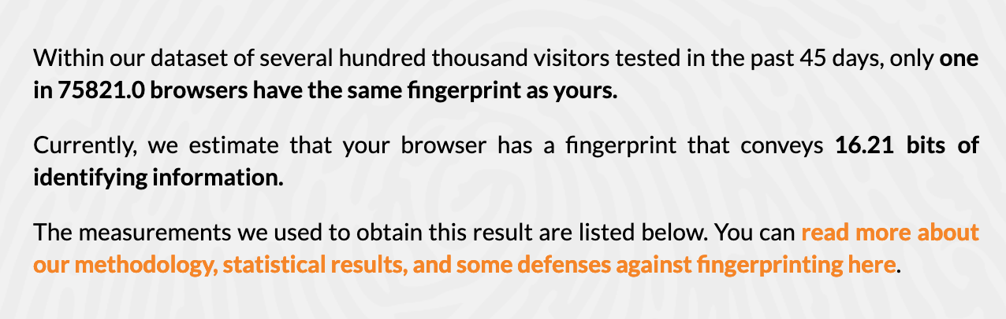
Panopticlick
https://panopticlick.eff.org
Information needed to uniquely identify a browser
n – number of connected devices: 5 000 000 000
log₂n – number of bits for a unique id: 33 bits
Idea: distinguish user’s browsers by accessing browser features and using their probability distributions

Slide 19
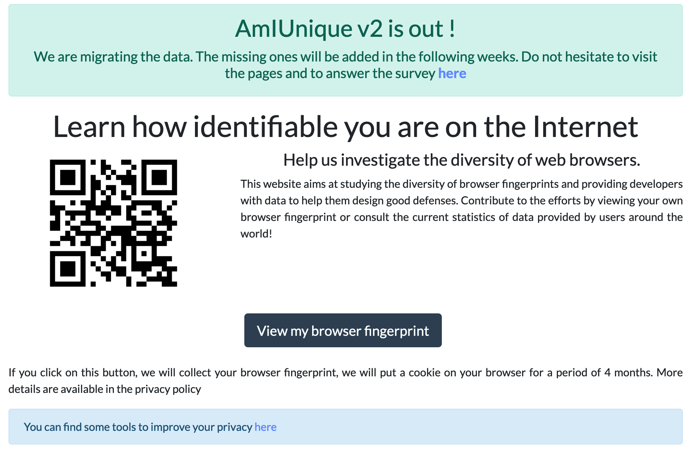
Am I Unique
https://amiunique.org/
Website launched in November 2014
Collected 660,000+ fingerprints so far
Browser extension available to see the evolution of your own browser fingerprint

Slide 20
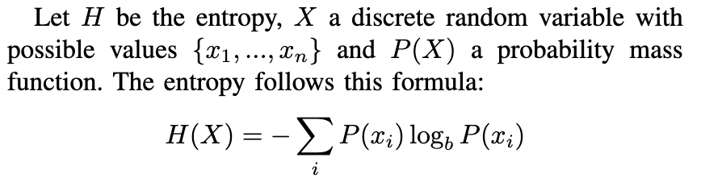
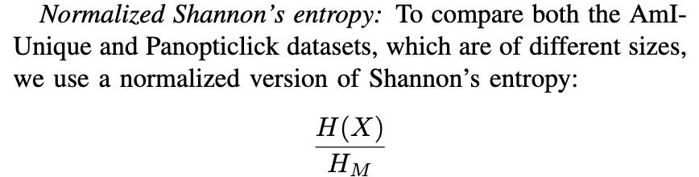
Metric for computing uniqueness
Entropy
Comparing across different size dataset
H_{M} = log₂(N) with N being the number of fingerprints in the dataset

Slide 21
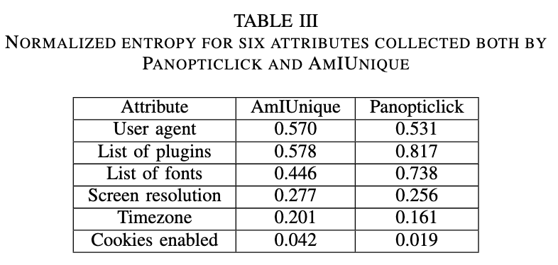
Comparing Panopticlick and AmIUnique
AmIunique dataset: identifying 90% of desktop fingerprints. This number is lower for mobile fingerprints at 81%, yet still quite effective

Slide 22
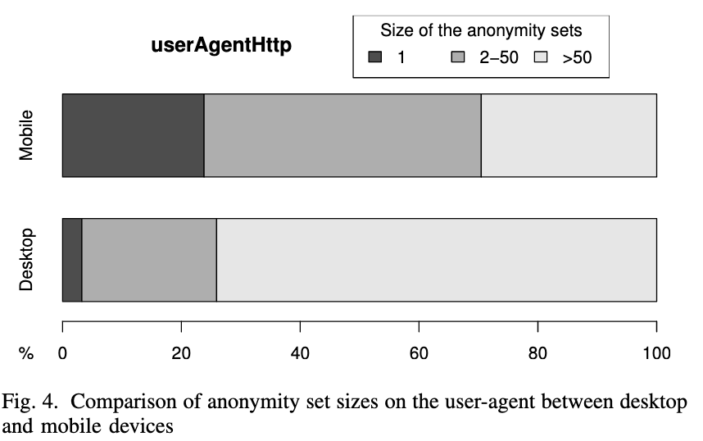
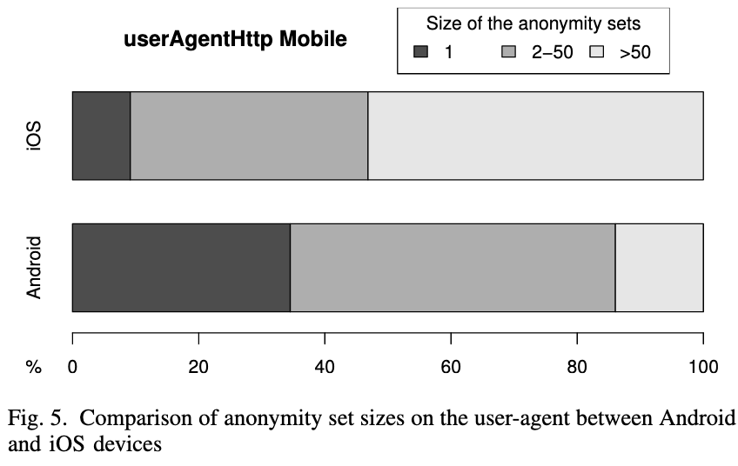
Comparing based on platforms
User-agent for desktop Vs. Mobile
User-agent for iOS Vs. Android
User-agent string:
Mozilla/5.0 (Windows NT 6.1; WOW64; rv:34.0) Gecko/20100101 Firefox/34.0
Mozilla/5.0 (Android; Mobile; rv:27.0) Gecko/27.0 Firefox/27.0

Slide 23
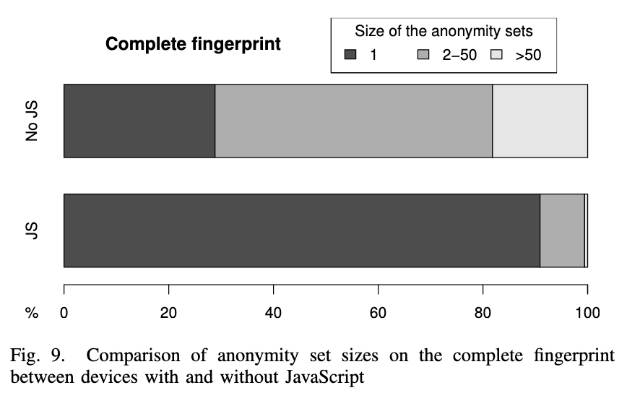
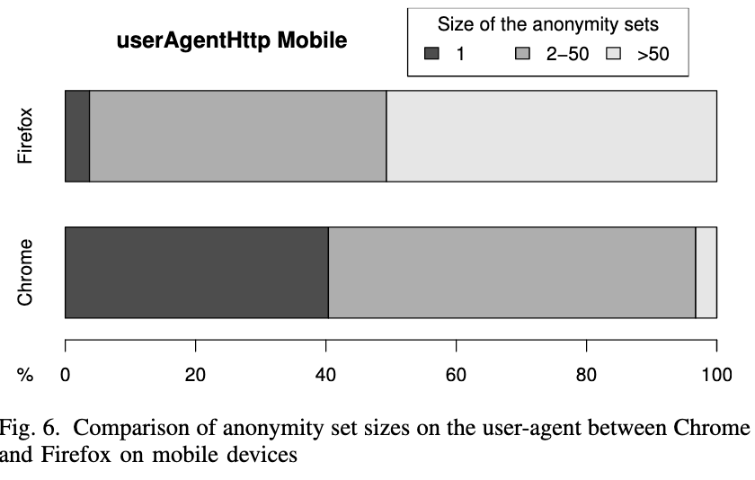
Comparing based on browsers and JS
JS Vs. no-JS
Chrome Vs. Firefox

Slide 24
Summary
Servers can easily collect information about a device to form what is called a browser fingerprint.
There is so much diversity that users can be tracked online if their fingerprint is unique.
Test your device on https://amiunique.org and https://panopticlick.eff.org

Slide 25
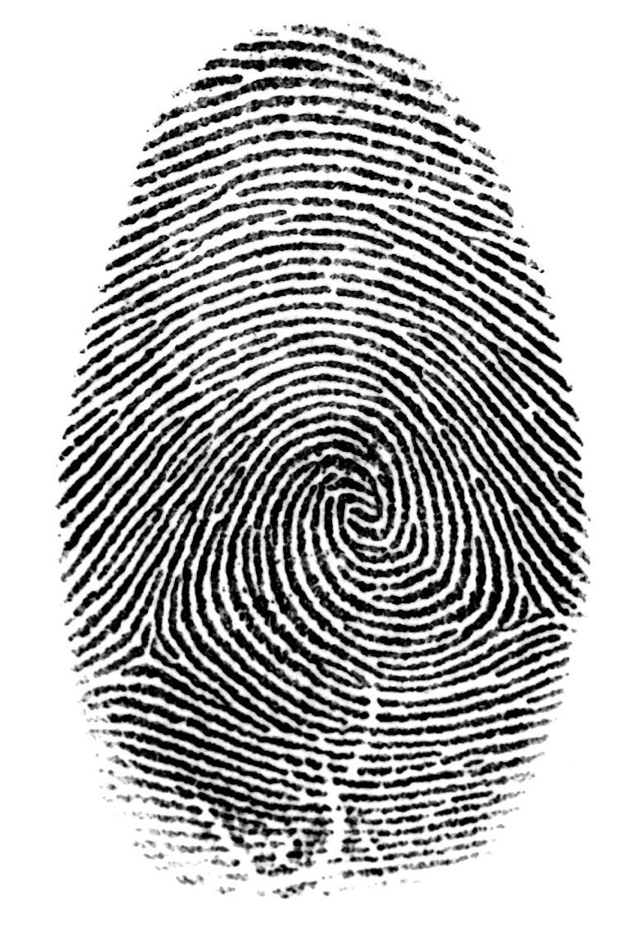
Very hard to opt-out
Even if
you delete all the cookies
you clean all the storages (HTML5, Flash)
you use browser private mode
…your fingerprint remains the same!

Slide 26
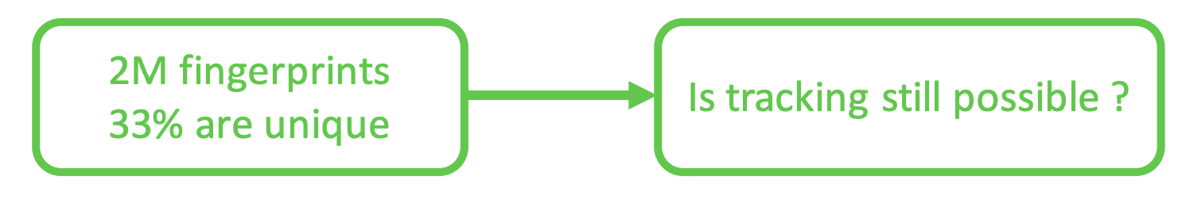
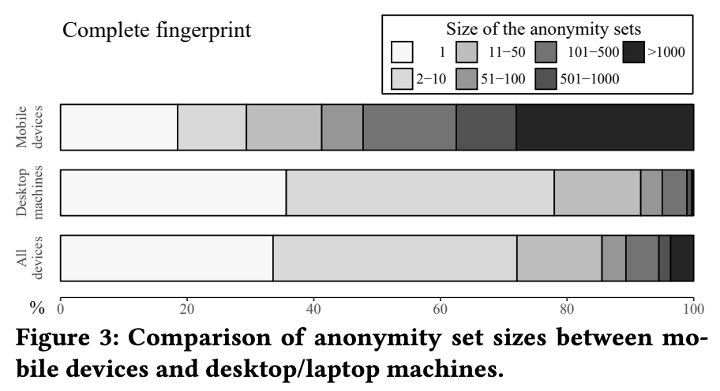
How effective is fingerprinting at large scale?
Larger population
Same geographic location (time-zone similar)
What difference do we see?
Not as effective
90% vs 33.6% desktop
81% vs. 18.5% mobile
Hiding in the Crowd: an Analysis of the Effectiveness of Browser Fingerprinting at Large Scale Alejandro Gómez-Boix, Pierre Laperdrix, Benoit Baudry The Web Conference (WWW 2018)

Slide 27
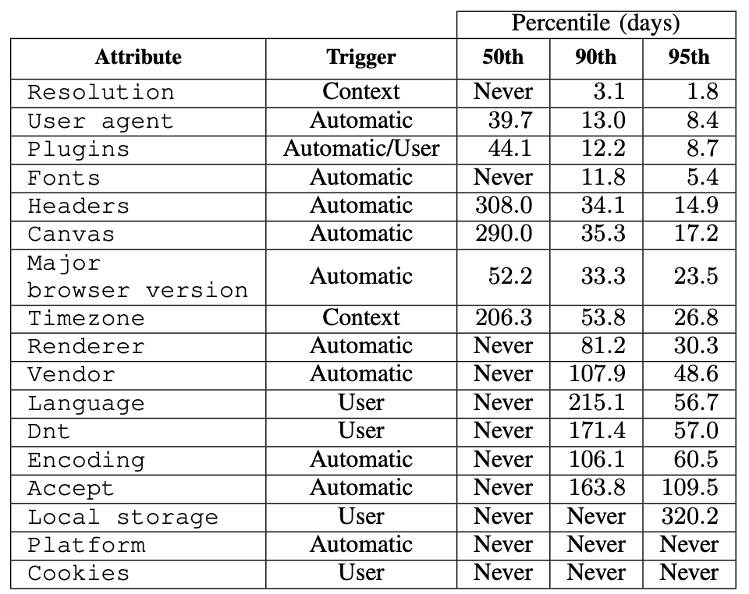
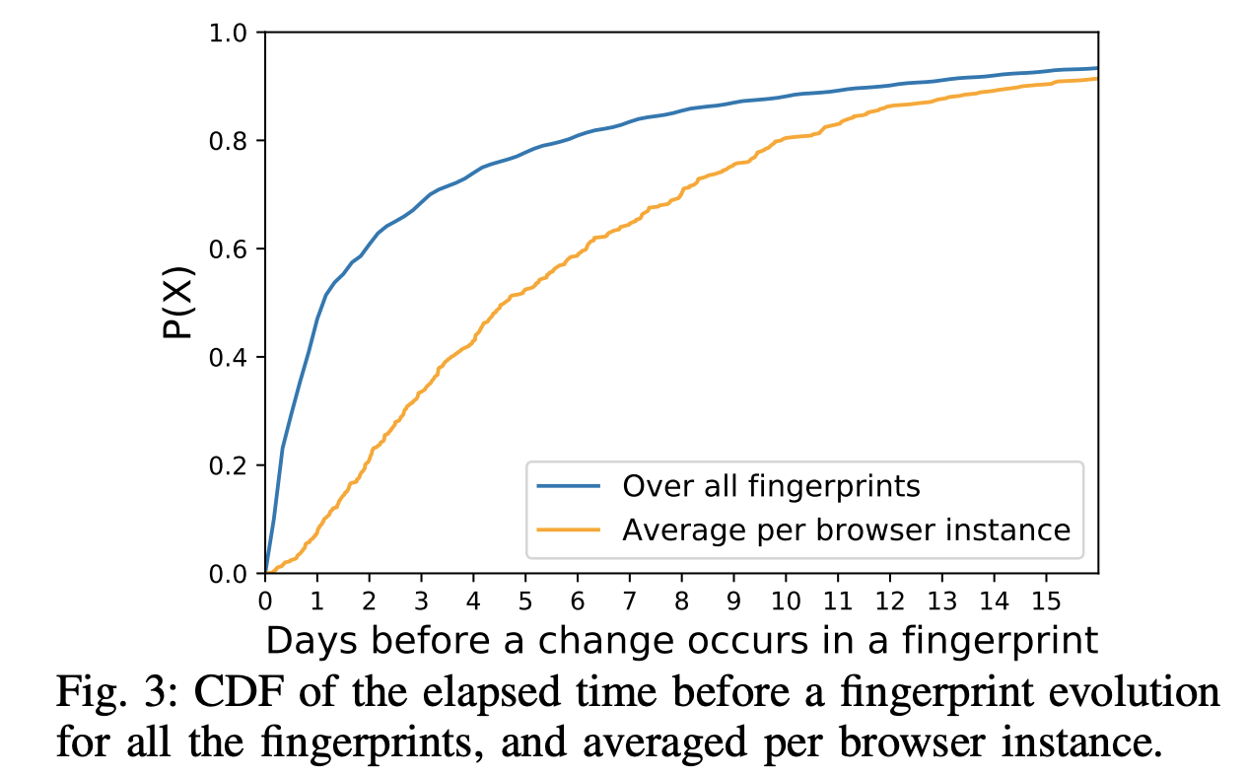
What if fingerprints change over time?
This means the probability that at least one transition occurs in 13 days is 0.9 (blue).
50% of the browsers never see a change in resolution whereas 10% see a change in avg. 3.1 days
Some attributes change more frequently than others
FP-Stalker: Tracking Browser Fingerprint Evolutions. Antoine Vastel, Pierre Laperdrix, Walter Rudametkin, Romain Rouvoy, IEEE S&P, 2018
Notes:
50% of the browser never see a change in resolution whereas 10% see a change in avg. 3.1 days

Slide 28
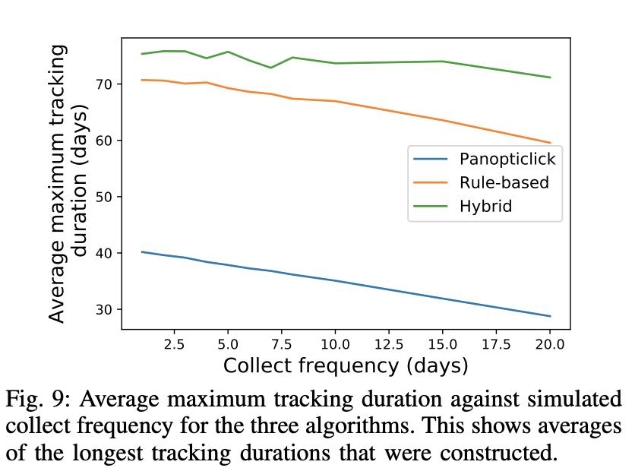
Using ML to link fingerprints
Compute the probability that two fingerprints originate from the same browser using Random forest.
On avg. 75 days of tracking capability through this approach

Slide 29
Extension fingerprint

Slide 30
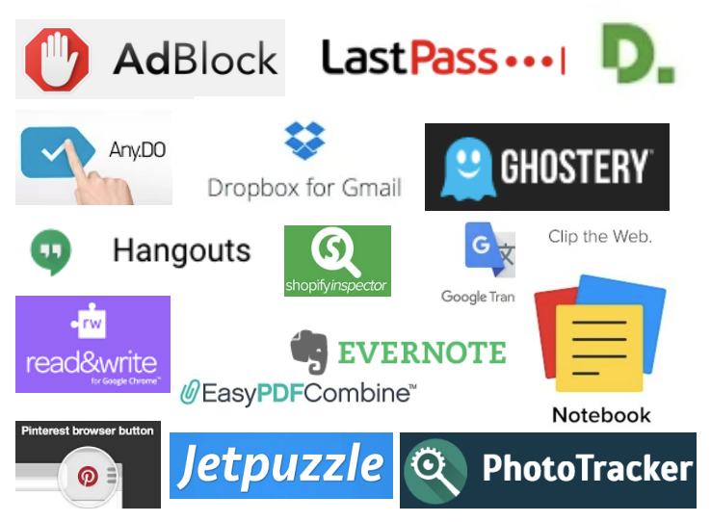
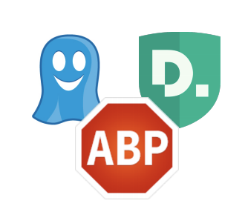
Many extensions out there
What about privacy-enhancing extensions?
• Privacy Paradox
Users’ fingerprints can be enriched by their browser extensions

Slide 31
Fingerprinting users by their Browser extensions
Fingerprintable
Surface
Extension_A
Extension_C
Extension_B

Slide 32


Browser Plugins vs Extensions
Plugins display non traditional HTML content
Examples:
Flash, Java, Sliverlight
All installed plugins are accessible via navigator.plugins JavaScript object
Extensions extend or modify default behavior of a browser
Examples:
AdBlockPlus, LastPass, Ghostery, Pinterest
No API that webpages can use to detect all installed extensions

Slide 33
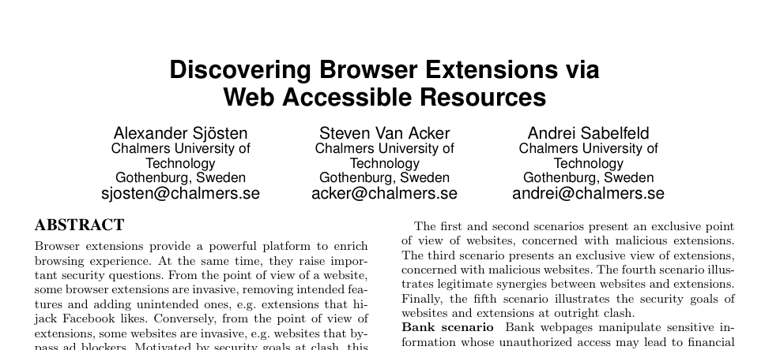
Browser extension detection
via Web Accessible Resources (ongoing)
chrome-extension://gpdjojdkbbmdfjfahjcgigfpmkopogic/img/icon_48.png
unique extension ID
try it out: http://blueberry-cobbler-11673.herokuapp.com/

Slide 34
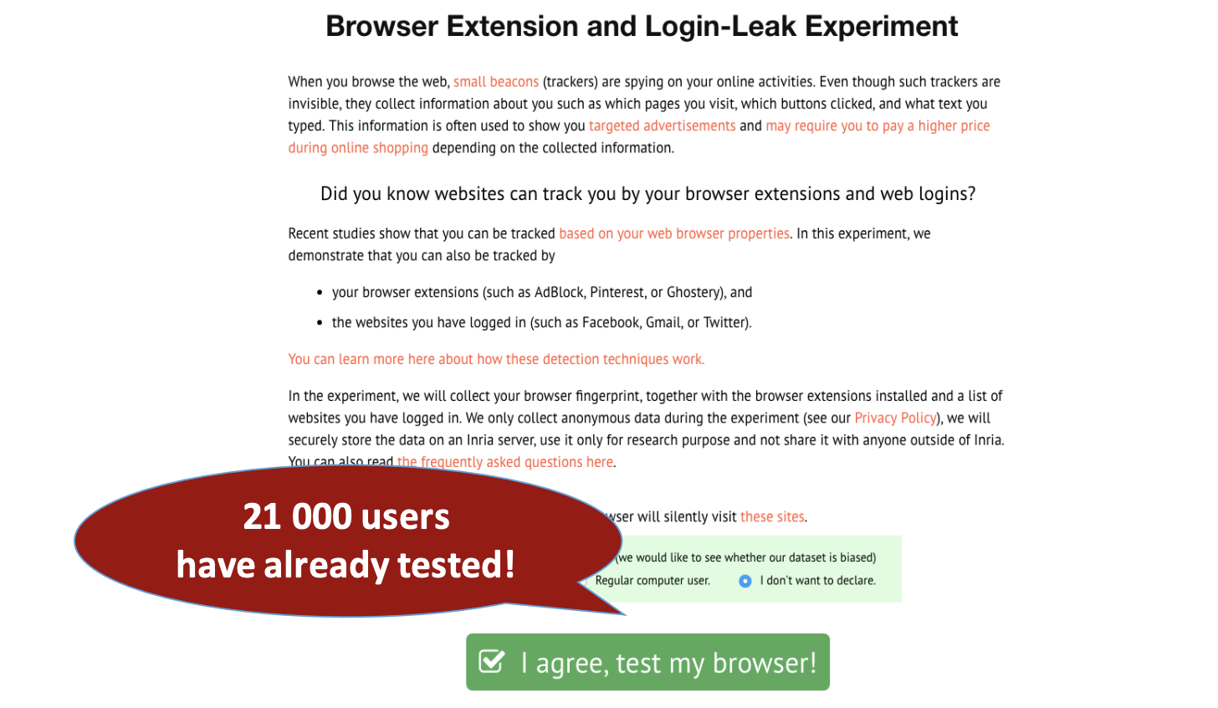
Browser extension study
https://extensions.inrialpes.fr
G.G. Gulyás, D. F. Some, N. Bielova and C. Castelluccia. To Extend or not to Extend: on the Uniqueness of Browser Extensions and Web Logins. WPES@ACM CCS 2018.

Slide 35
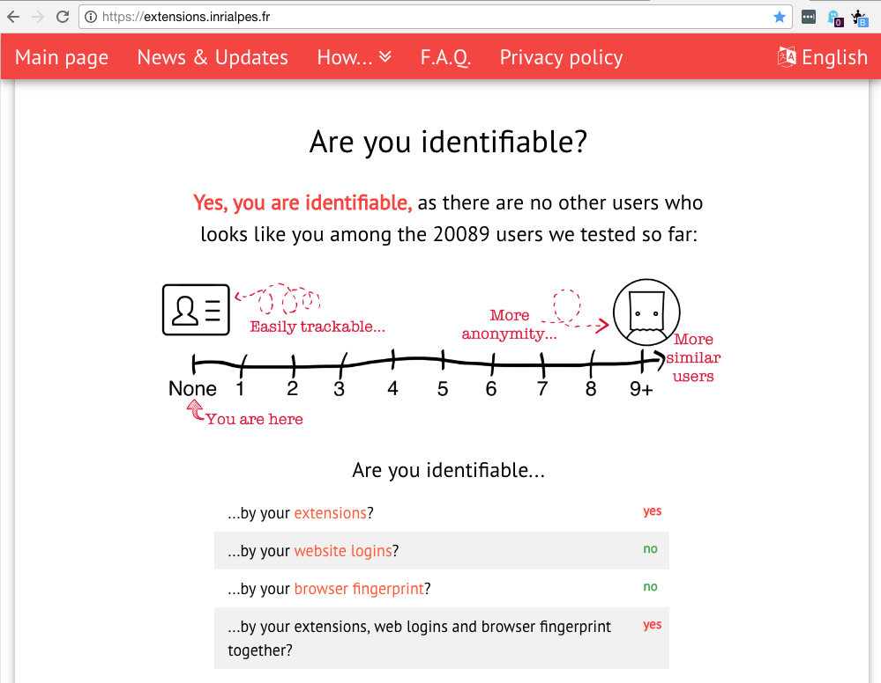
Combining extensions and other properties
try it out: https://extensions.inrialpes.fr/

Slide 36
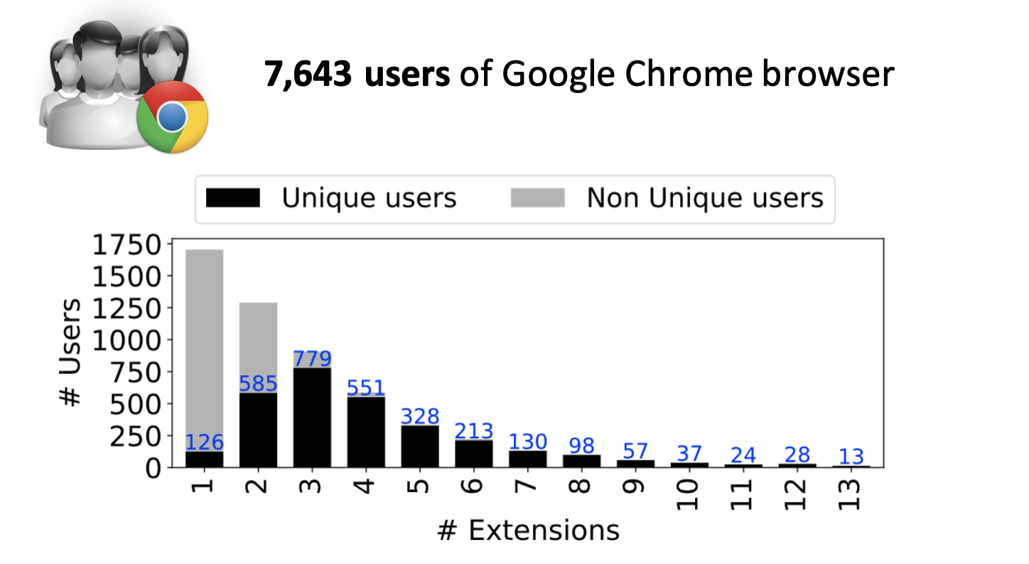
How many extensions users have?

Slide 37
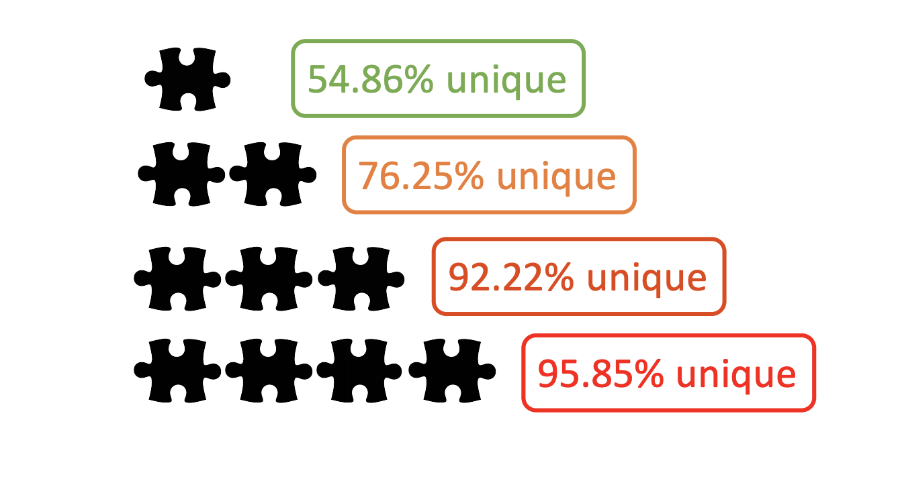
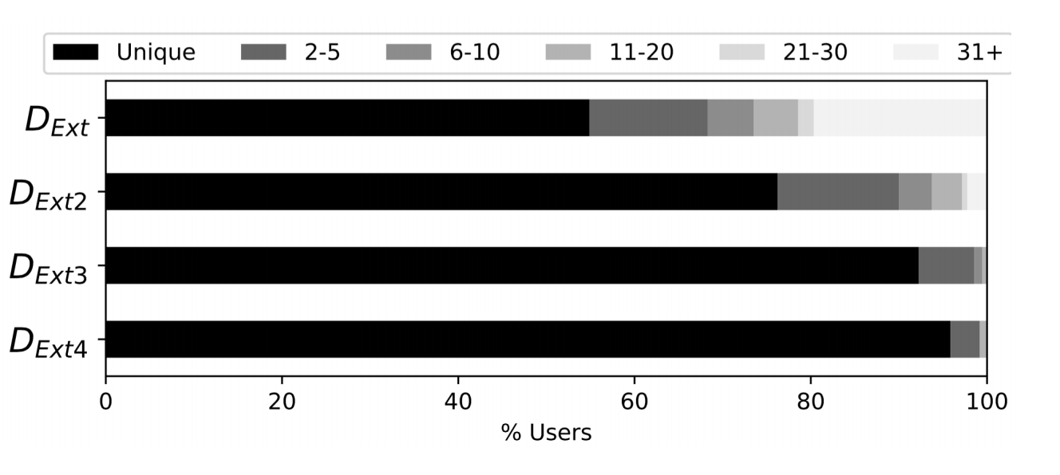
Am I really unique if I use a few extensions?

Slide 38
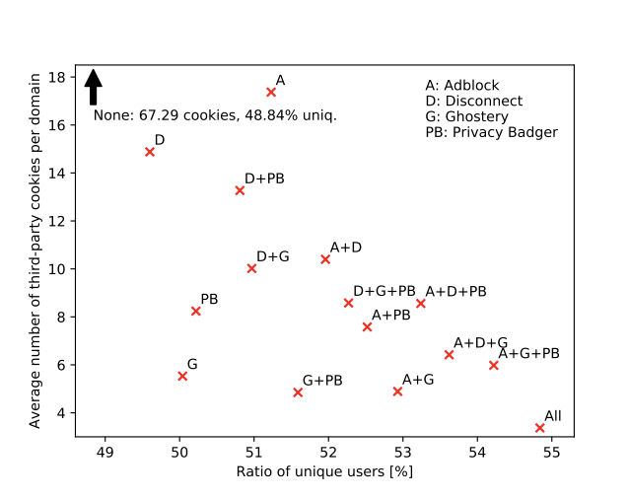
The dilemma of privacy extensions
Less protected (15 cookies accepted)
Harder to track (49.7%)
Privacy extensions block some trackers
Privacy extensions make a user more unique
What is the trade-off between privacy gain (some trackers are blocked) and privacy loss (user is more unique)?
More protected (3 cookies accepted)
Easier to track (54.8%)

Slide 39
Hardware fingerprint

Slide 40
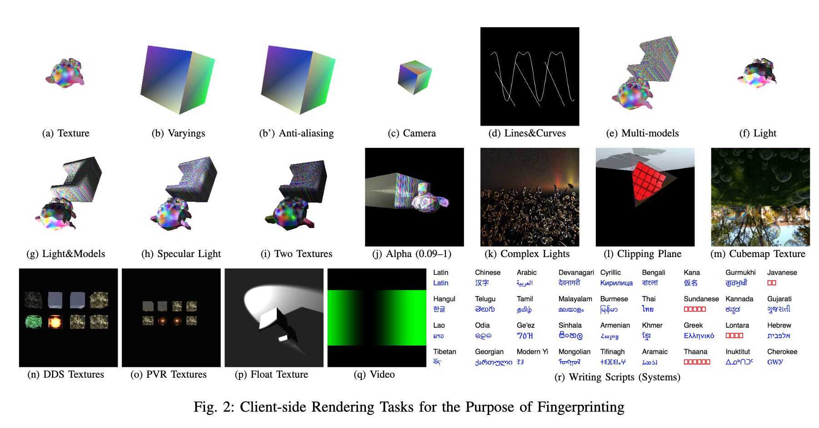
Variation in hardware
http://uniquemachine.org/
Exploit variation in the OS, and graphic card to track users
graphic cards exposed by WebGL
audio stack by Audio-Context
CPU by hardwareConcurrency.
(Cross-)Browser Fingerprinting via OS and Hardware Level Features. Yinzhi Cao, Song Li, Erik Wijmans, 2017

Slide 41
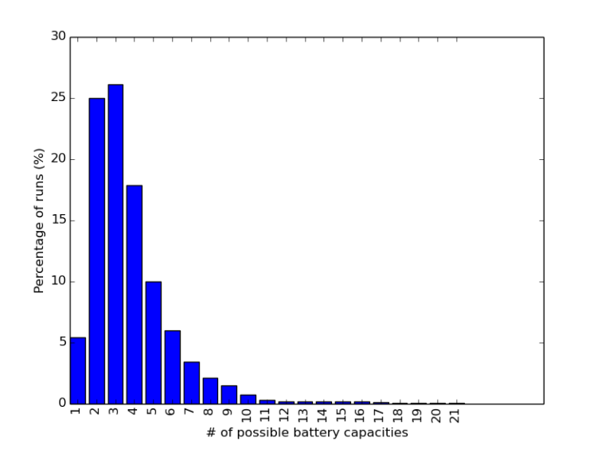
Tracking through battery level
HTML5 Battery Status API:
Full capacity varies across users
Current level also varies across users
Firefox was only supporting this – now deprecates as of 2018

Slide 42
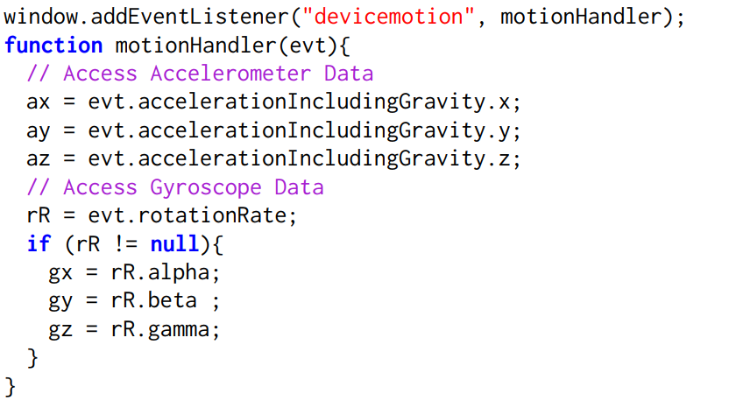
Tracking through motion sensors
Touch Events
Vibration
WebXR (VR/AR support)
Sensors
Orientation
Motion
Ambient Light
Proximity

Slide 43
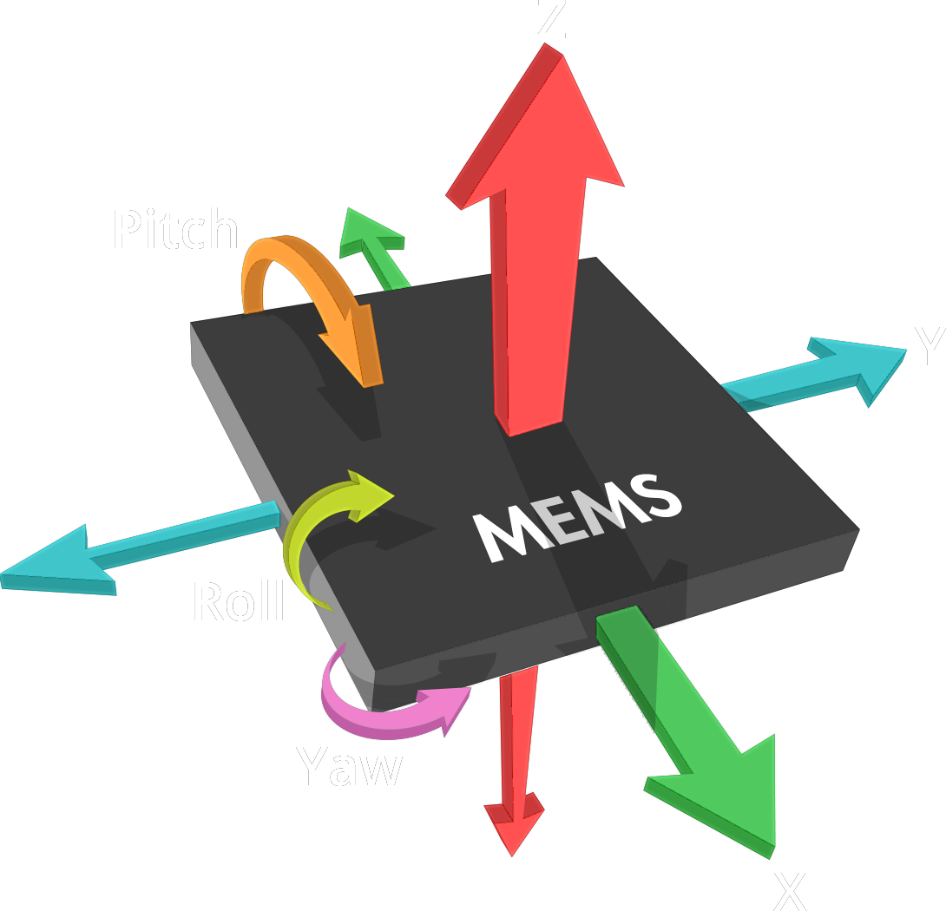
Sensor APIs
Orientation
Orientation about the X, Y, Z axis (°)
Motion
Accelerometer (m/s²)
Accelerometer w/o gravity (m/s²)
Gyroscope (°/s)
Ambient light
Light sensor (lux)
Proximity
Proximity sensor (cm)
Notes:
add compat table

Slide 44
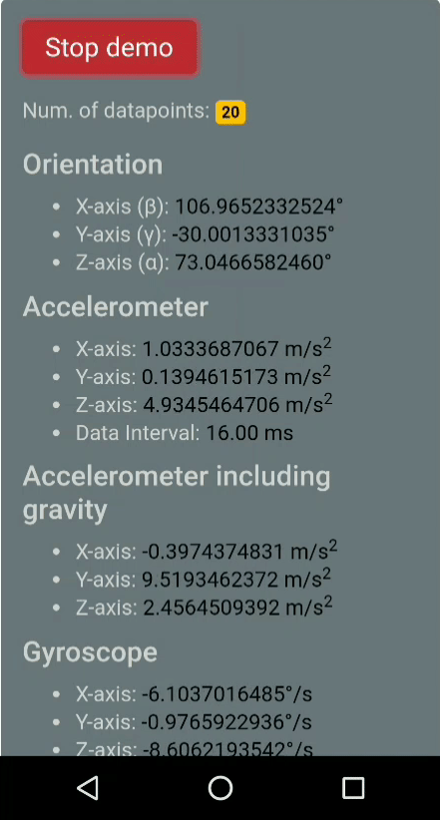
No Permissions for Sensor APIs
Available to any web page without permission check
Try it! https://sensor-js.xyz/demo
Notes:
- demo: we don't do anything with this data, but this may not

Slide 45





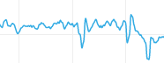
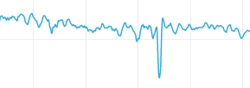
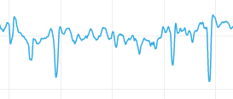
Setup
Attack Scenario: Fingerprint smartphones via accelerometers and gyroscopes
Designed a web page to collect motion sensor readings
Collect ten 5-second samples
Capture sensor streams

Slide 46
Technique
mean
features
var
power
...
Training traces
Test trace
classifier
Identify

Slide 47
Fingerprinting Performance
Recruit users through email survey and Mechanical Turk
Capture ten 5-second samples in both on-desk and in-hand
294 on-desk samples and 256 in-hand
Accuracy
 | On Desk | In Hand
k-NN | 42% | 28%
Random Forest | 80% | 67%
Extra Trees | 86% | 68%
Tracking Mobile Web Users Through Motion Sensors: Attacks and Defenses. Anupam Das, Nikita Borisov and Matthew Caesar. Network and Distributed System Security Symposium (NDSS), 2016.

Slide 48
Session Mixing
5 samples
5 samples
5 samples
5 samples
Train
10 Samples
Random
Split
Test

Slide 49
Session Splitting
 | On Desk | In Hand
k-NN | 42% | 28%
Random Forest | 80% | 67%
Extra Trees | 86% | 68%
Across Sessions (RF) | 57% | 45%
More features (RF) | 68% | 53%
Voting | 73% | 60%
5 samples
5 samples
5 samples
5 samples
Train
Test

Slide 50
Conclusion
Many ways to track users
As new APIs appear the threat increases
Every bit of information helps
Need to limit or control how information is retrieved.

Slide 51
Logistics
Home work 2 due Sept. 21 @11:59pm

